Slide 1

Exploring genome-wide organization of chromatin structure by ChIP-seq
Alon Goren
Department of Medicine,
UCSD

Slide 2
https://www.sciencemag.org/news/2017/09/are-preprints-future-biology-survival-guide-scientists

Slide 3
Study of the mitotic epigenomic landscape
Regulation of nucleosome deposition during mitosis

Slide 4
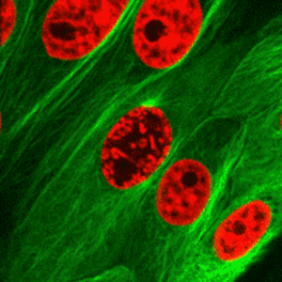
What serves as mitotic bookmarks for maintaining the epigenomic structure?
Mitotic changes:
Chromosome structure
RNAPol-II falls off (?)
Transcription ceases (?)
http://i.imgur.com/H11KQVx.gifv
Notes:
During mitosis:
1. Changes in chromosome structure.
2 .Components of general transcription machinery falls of the DNA (including RNA Polymerase).
3. Eviction of sequence specific TF’s from chromatin (many but not all).
4. Silences of transcription
In spite of these dramatic changes the accessibility of mitotic chromosomes to macromolecules remain high as can be seen by:
* Biophysical measurement
* Dnase I sensitivity assay
Chromatin structure and function is re-established immediately after mitosis
* The chromosomes decondense gradually along G1
* The interphase TAD structures is resumed within 4 hours after cytokinesis
* Transcription is resumed at the beginning of G1
How information is stored during mitosis is not clear
Generally -
some information is retained on the mitotic chromosomes and serves as “bookmarks” that allow for the re-establishment of the entire chromatin structure and function.

Slide 5
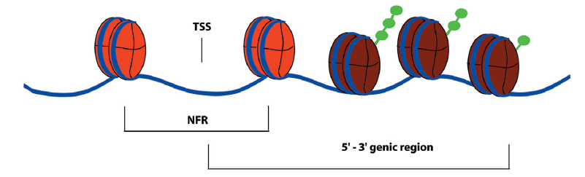
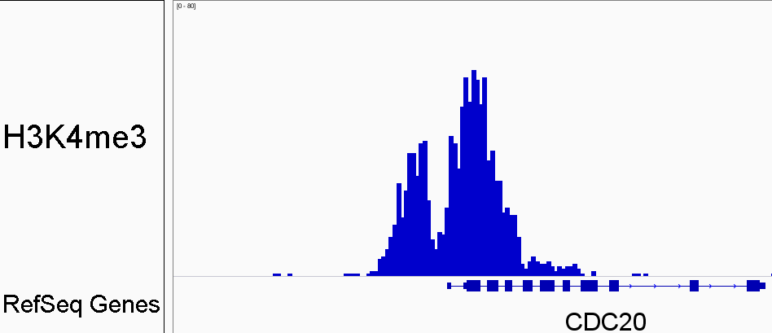
Nucleosome Free Regions (NFRs)
H3K4me3
RefSeq Genes
Lee et al. Nat. Genetics, 2004; Hawkins & Ren Human Molecular Genetics, 2006

Slide 6
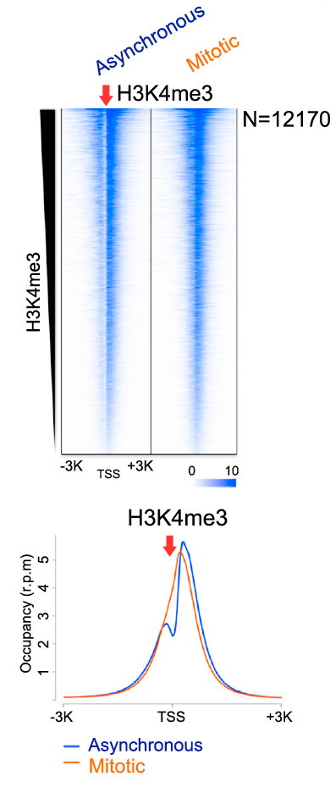
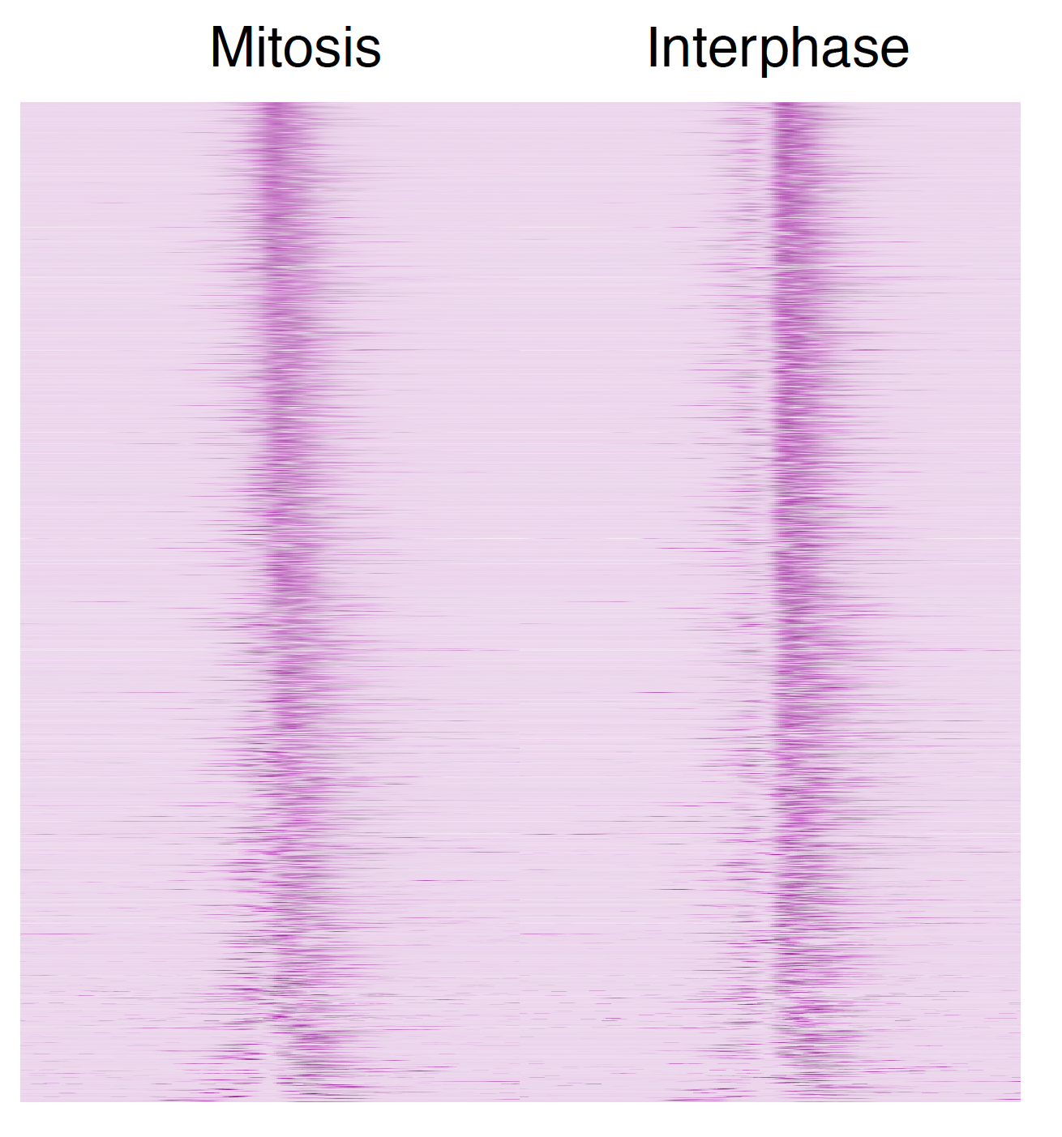
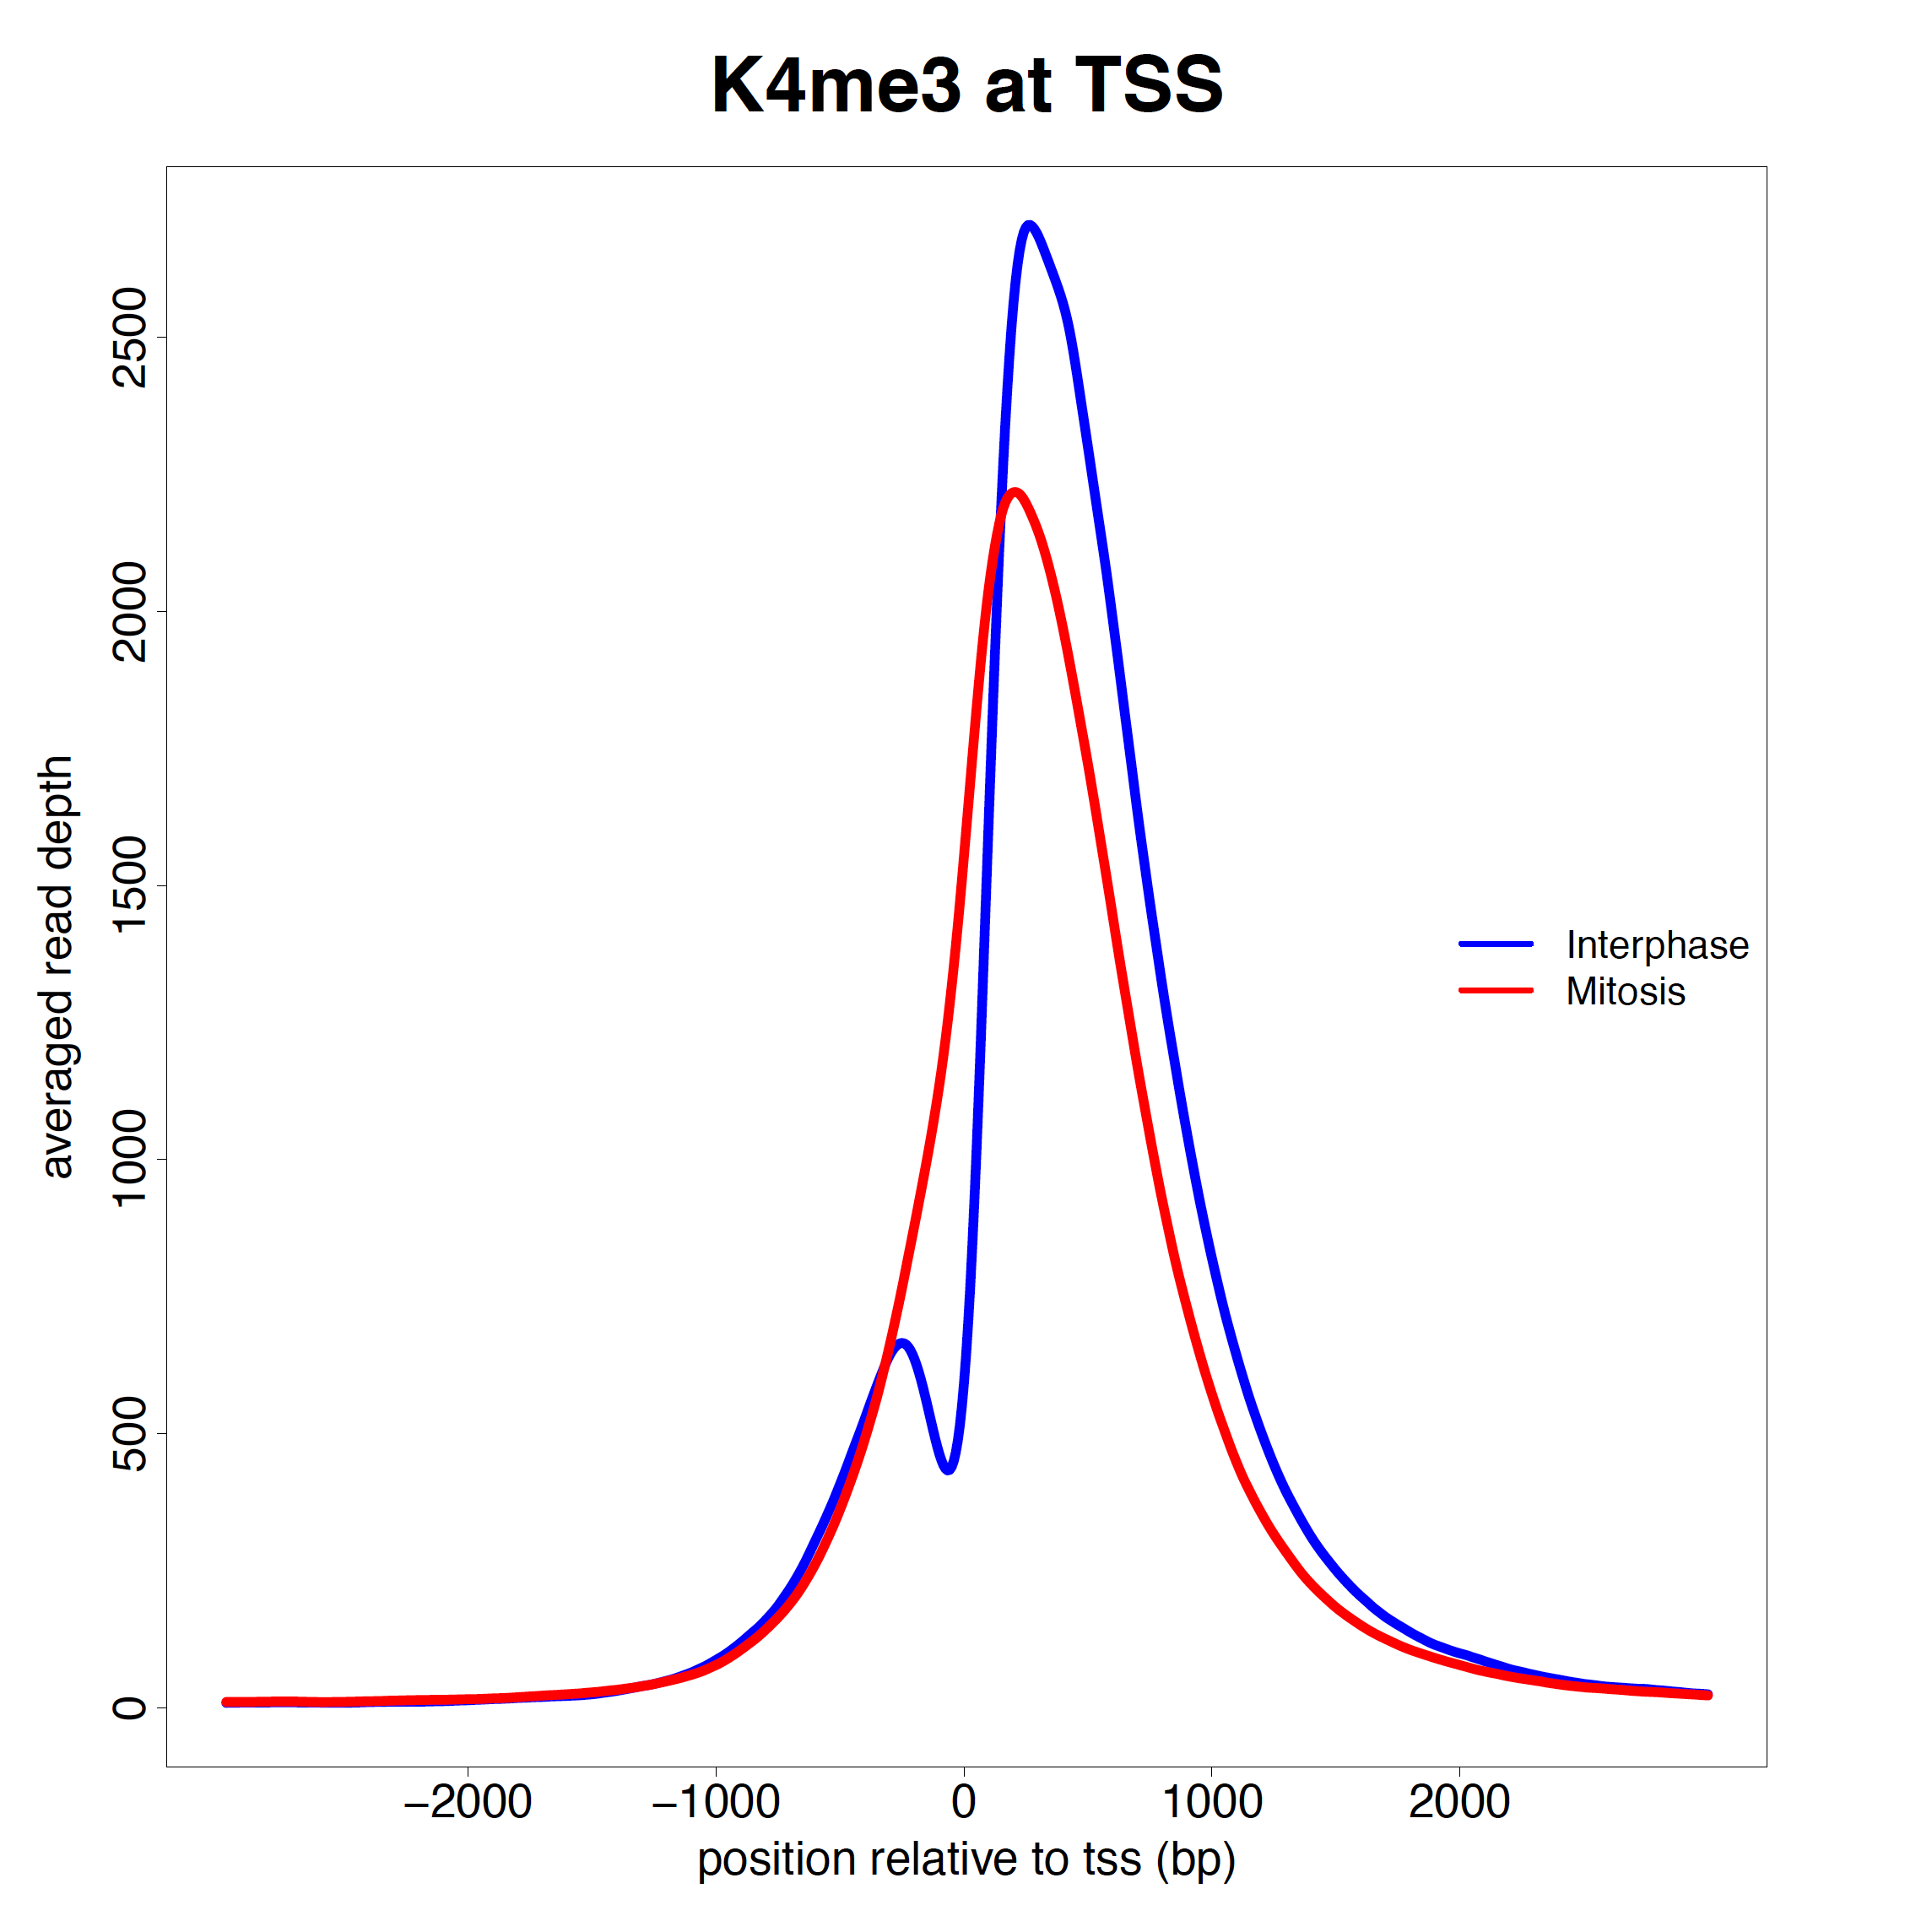
Loss of Nucleosome Free Regions (NFRs) during mitosis
Mitotic
Interphase
H3K4me3
Liang et al. Molecular Cell, 2015
Notes:
HeLa cells, synchronized in a different way:
We arrested human HeLa cells with a double thymidine block followed by nocodazole treatment and shake-off

Slide 7
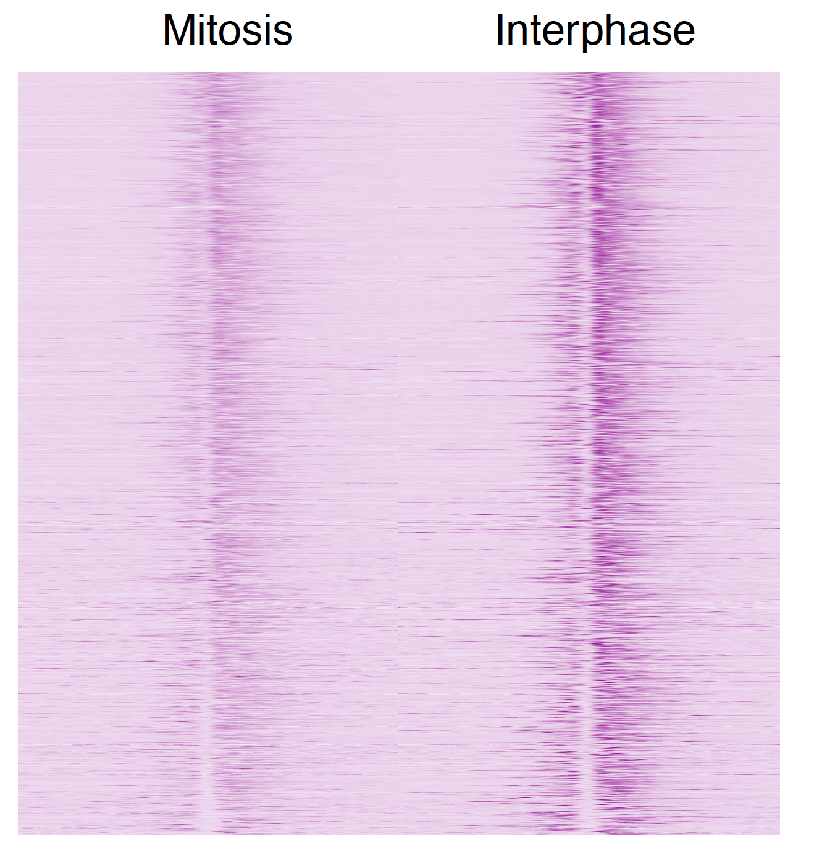
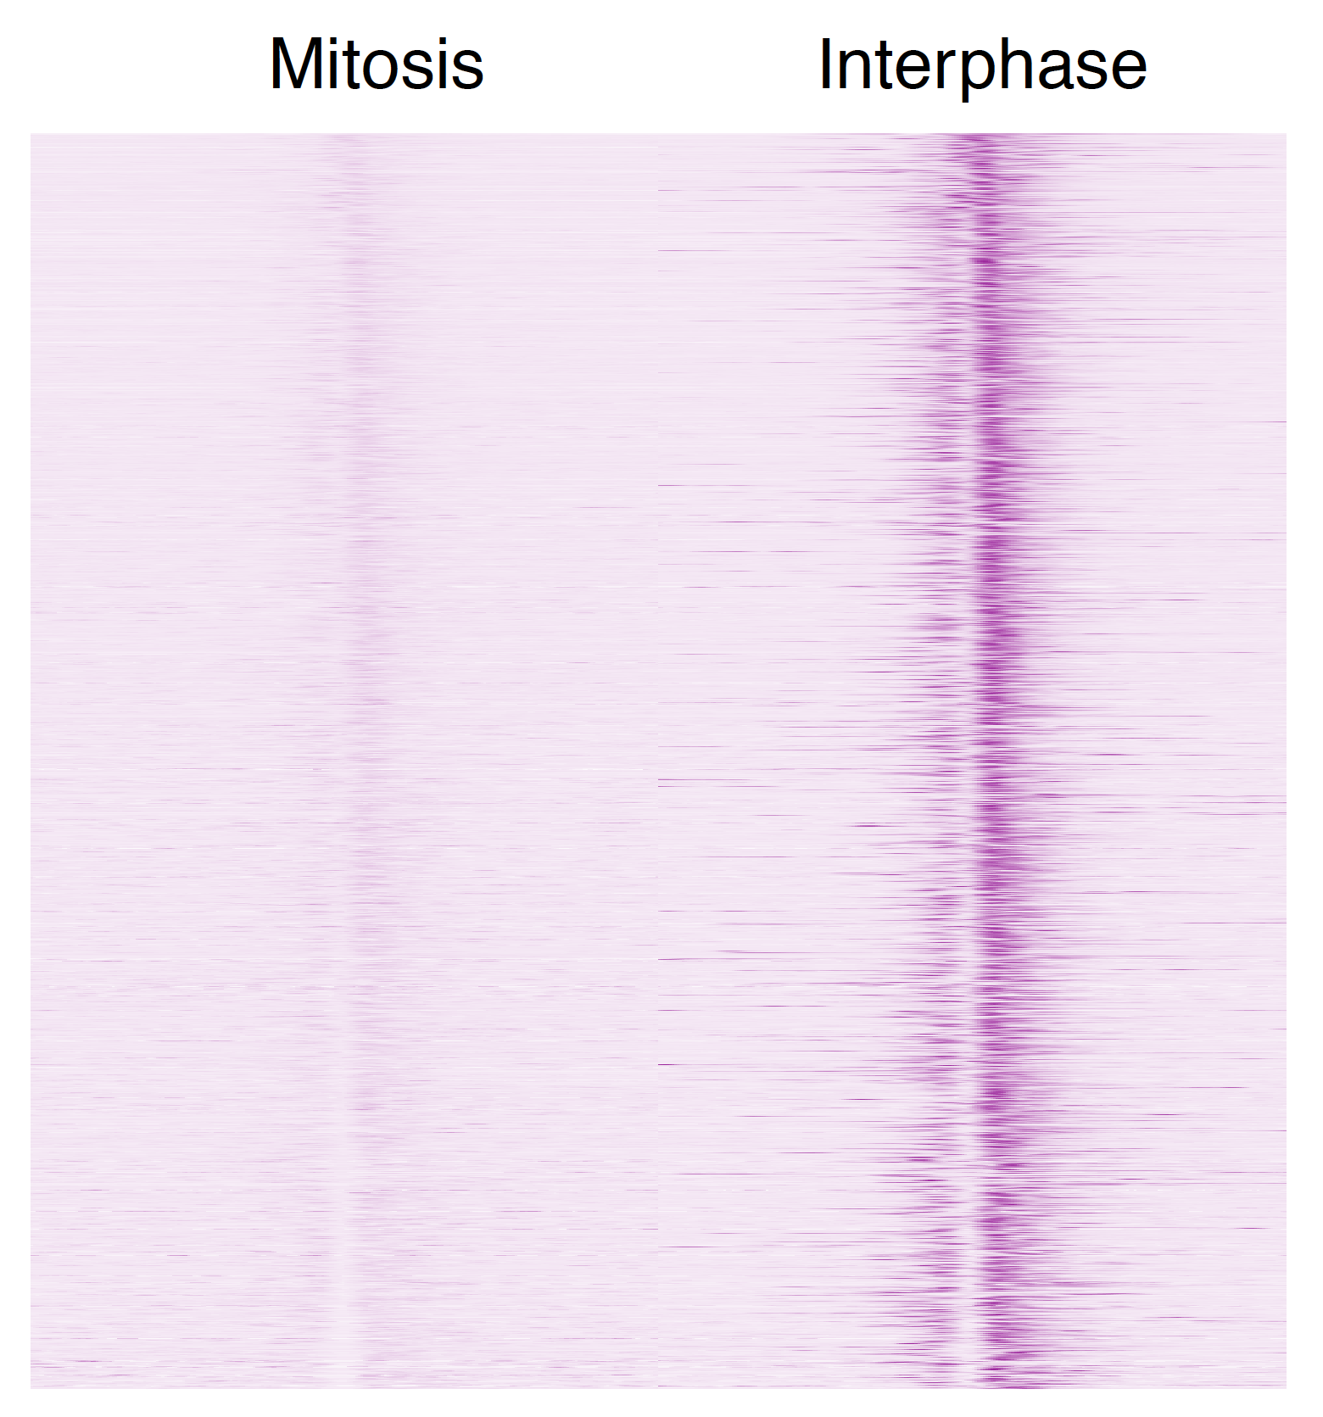
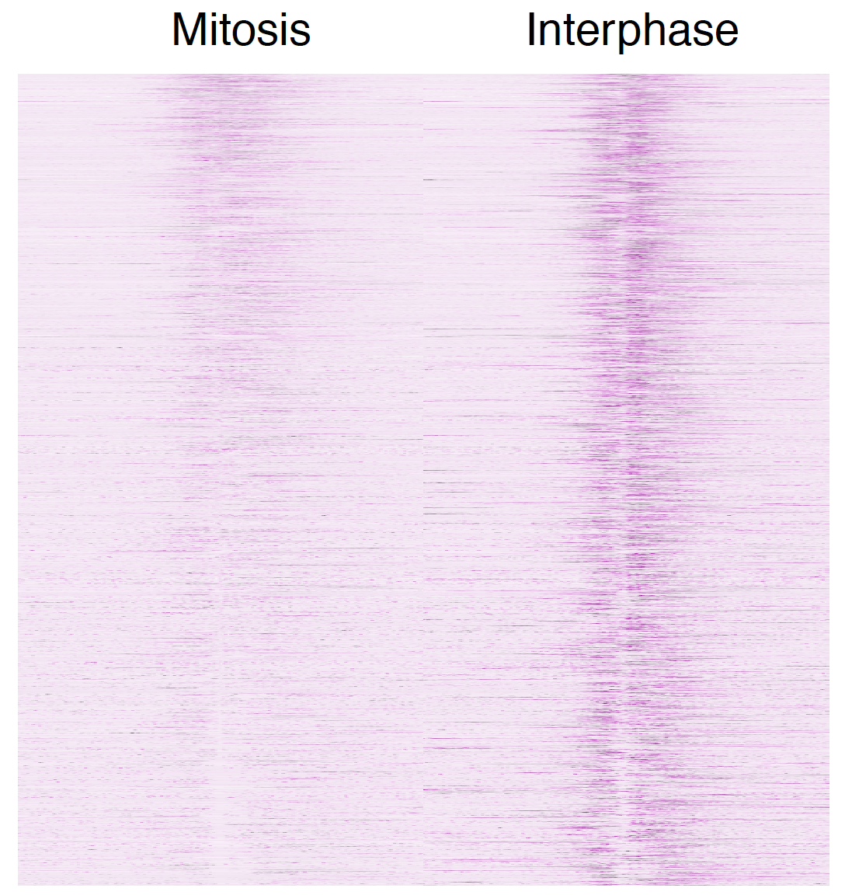
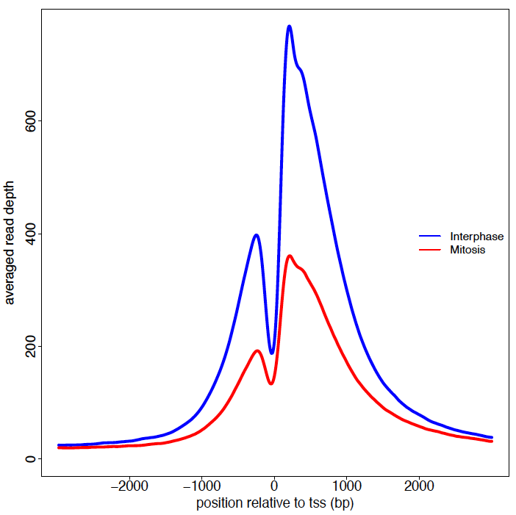
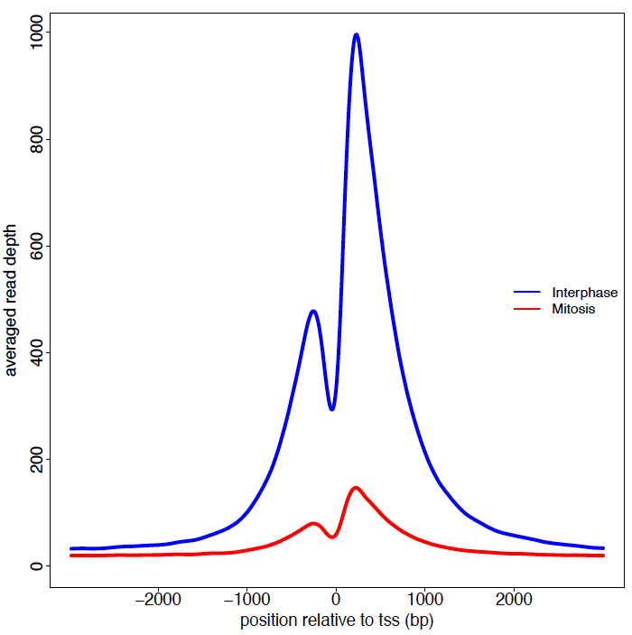
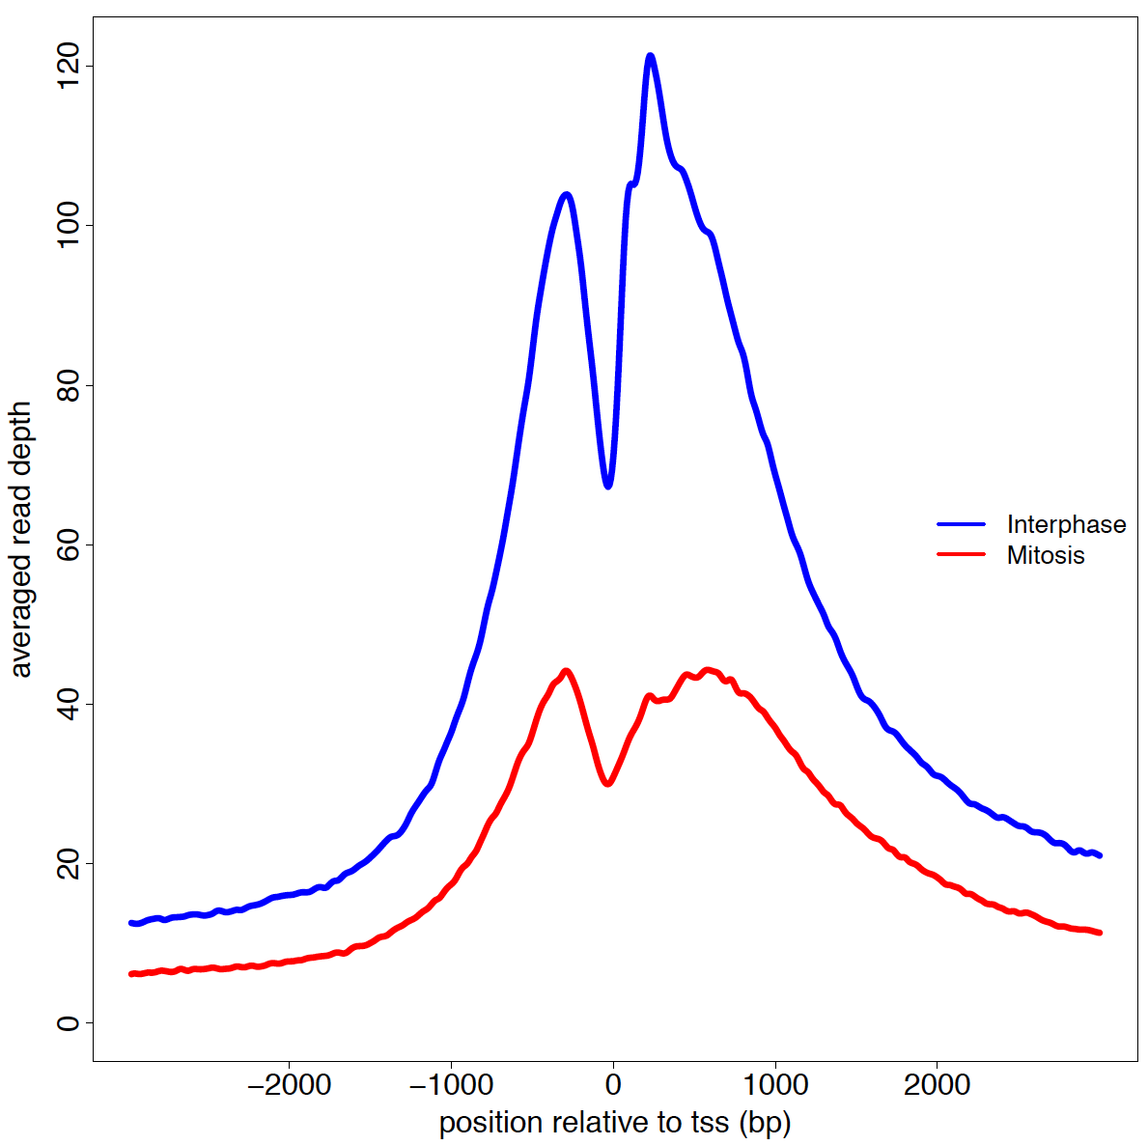
Histone acetylations retain mitotic NFR structure
& conserved in mouse
HeLaS
Mouse G1E cells
H3K9ac
H3K27ac
H3K27ac
Mouse data from: Hsiung et al. Genes & Dev, 2016
Notes:
G1E are murine
erythroblast cells

Slide 8
The NDR nucleosome is distinguishable from its surrounding
Javasky & Shamir et al., Genome Research 2018

Slide 9
The NDR nucleosome is distinguishable from its surrounding
Javasky & Shamir et al., Genome Research 2018

Slide 10
The TSS nucleosome is distinguishable from its surrounding

Slide 11
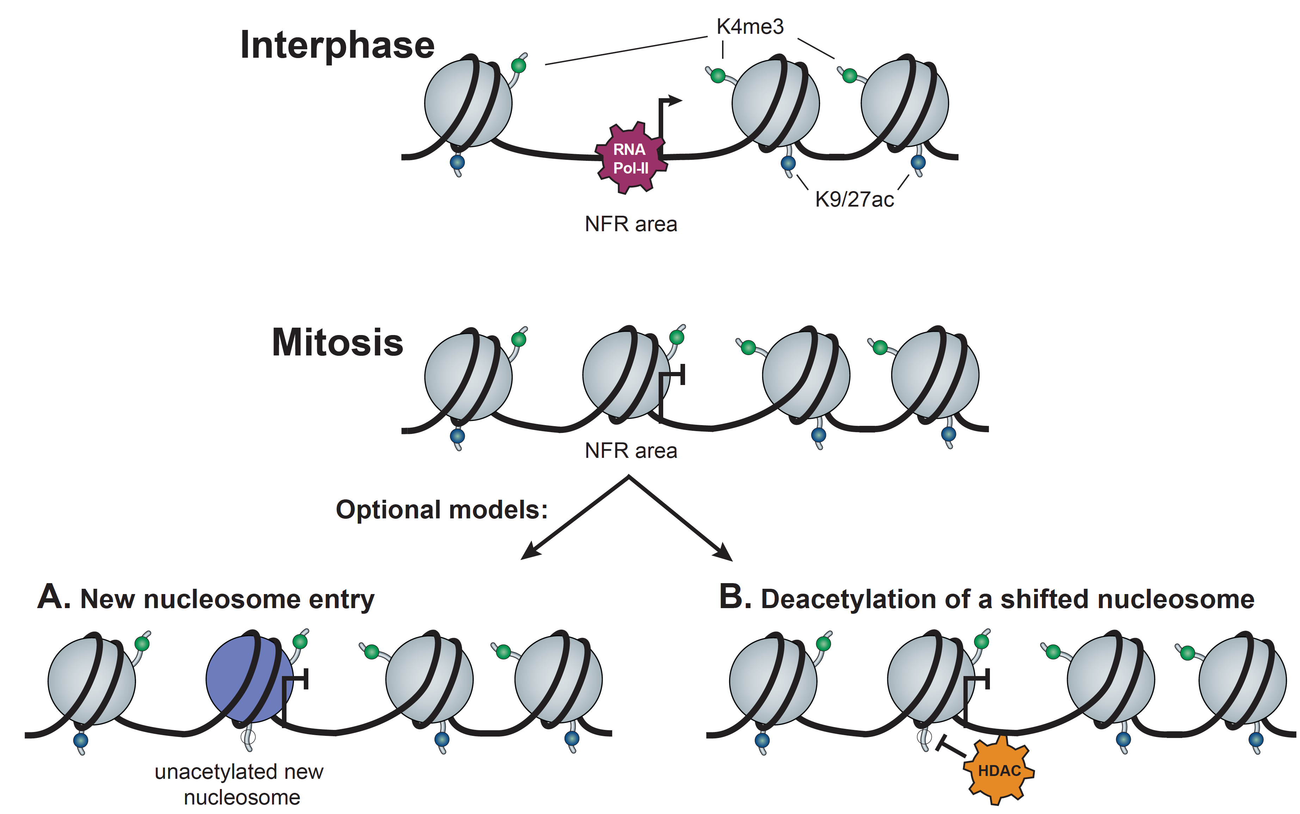
Possible models for explaining NFR loss

Slide 12
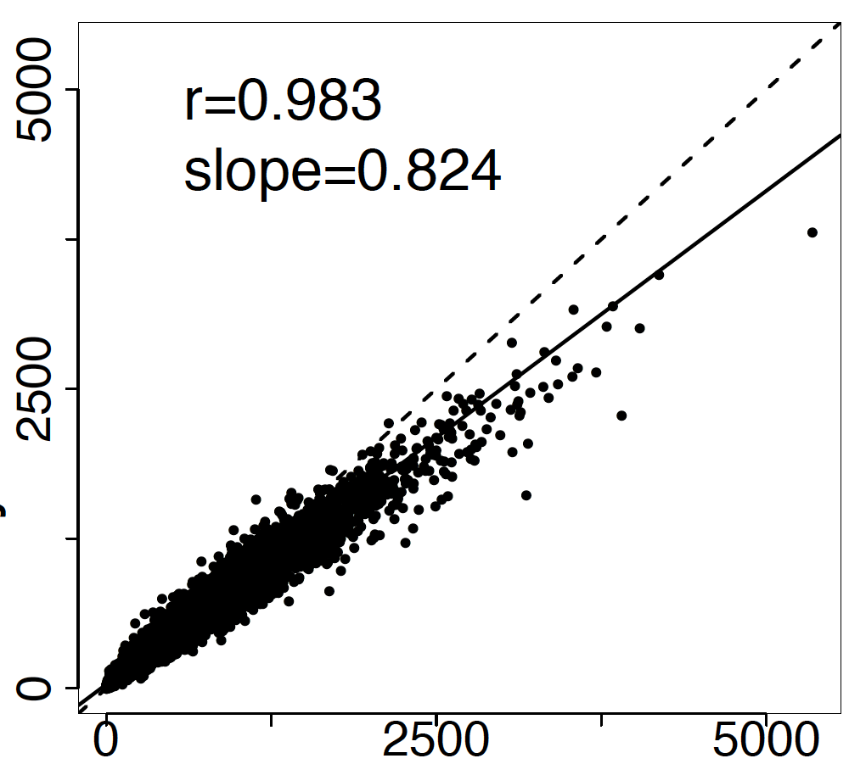
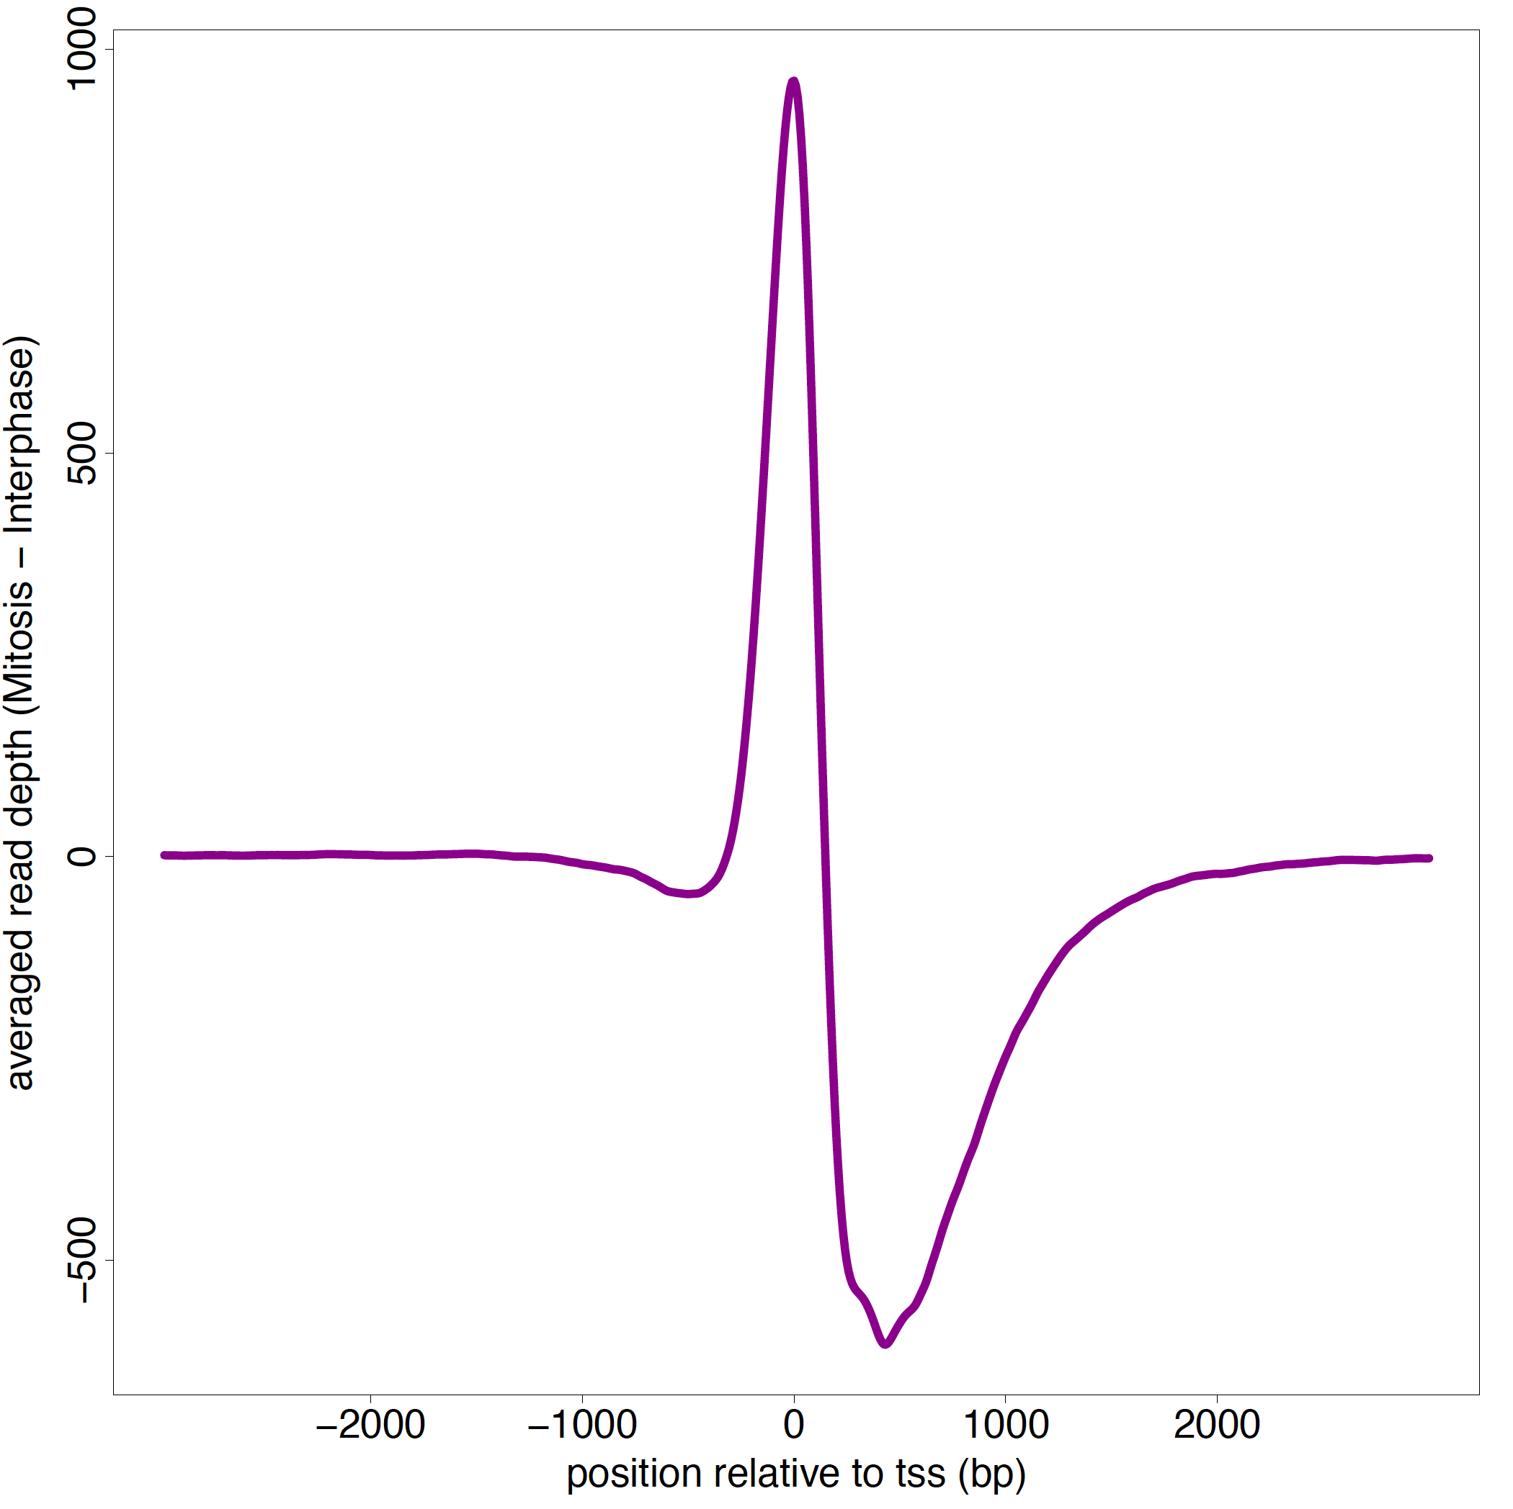
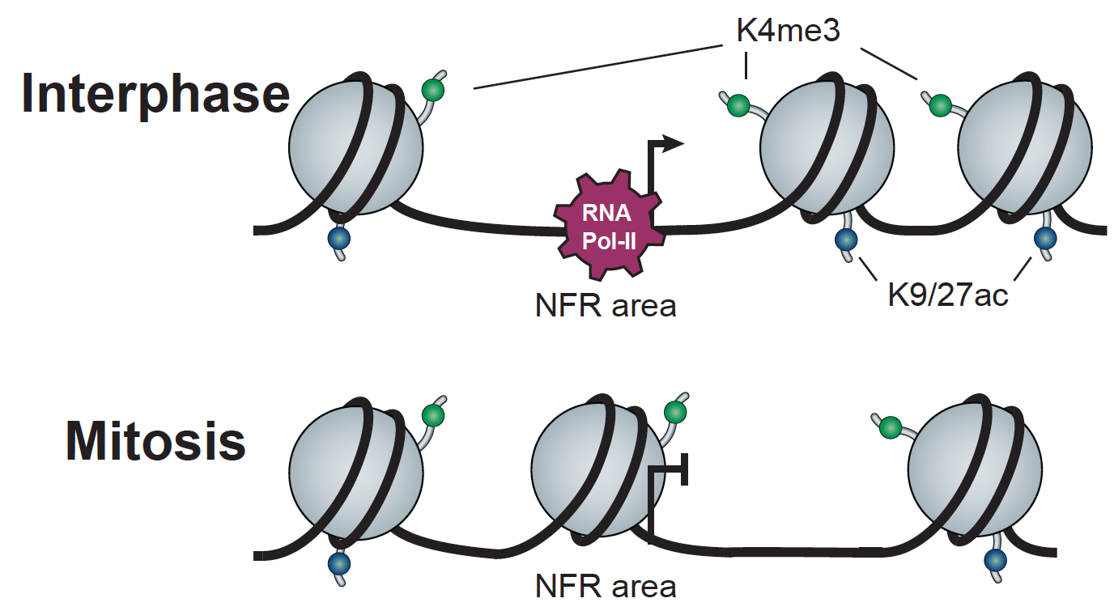
H3K4me3 patterns support for the nucleosome shift model
∆ of Mitosis to Interphase (H3K4me3)
H3K4me3 abundance
(Proteomics)
H3K4me3
Relative Abundance %
Mitosis
Interphase
Mitosis
Interphase

Slide 13
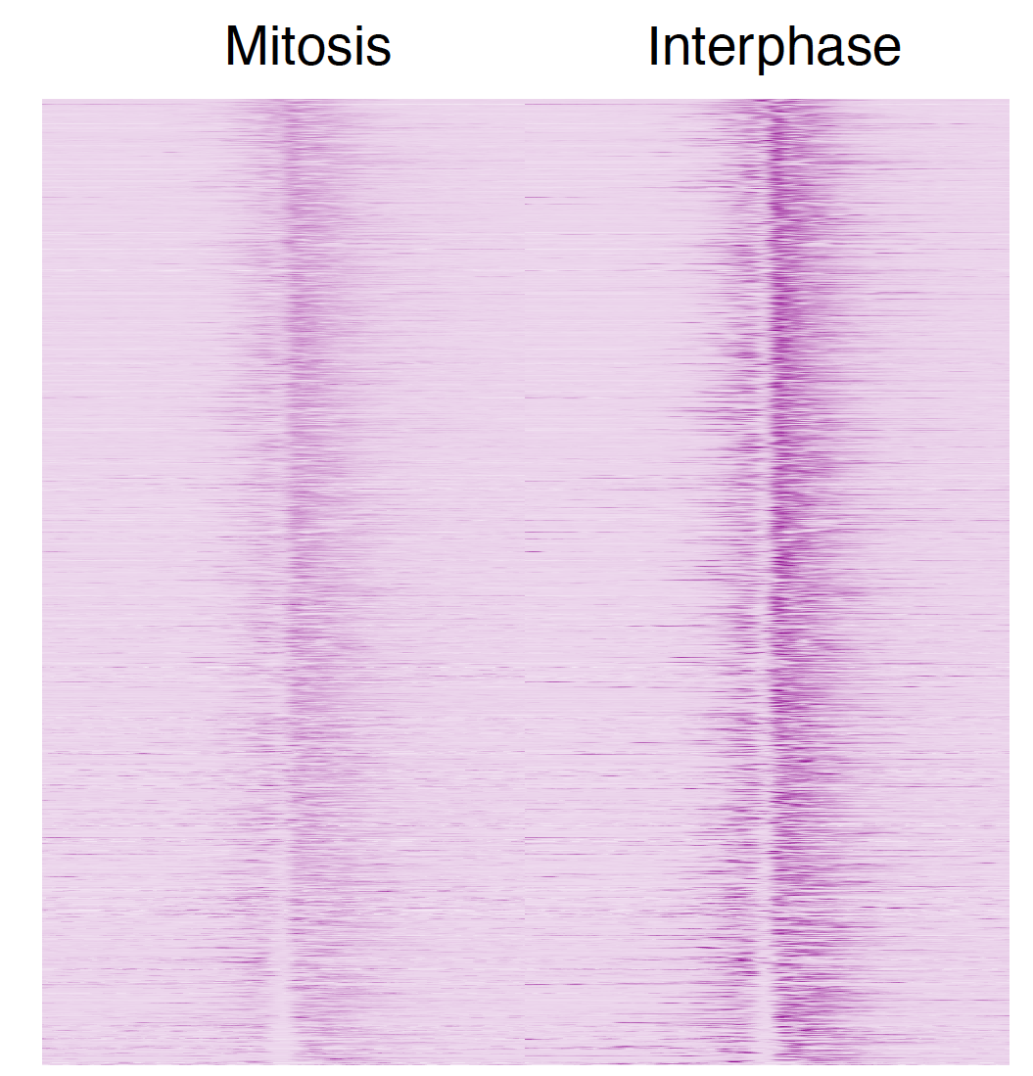
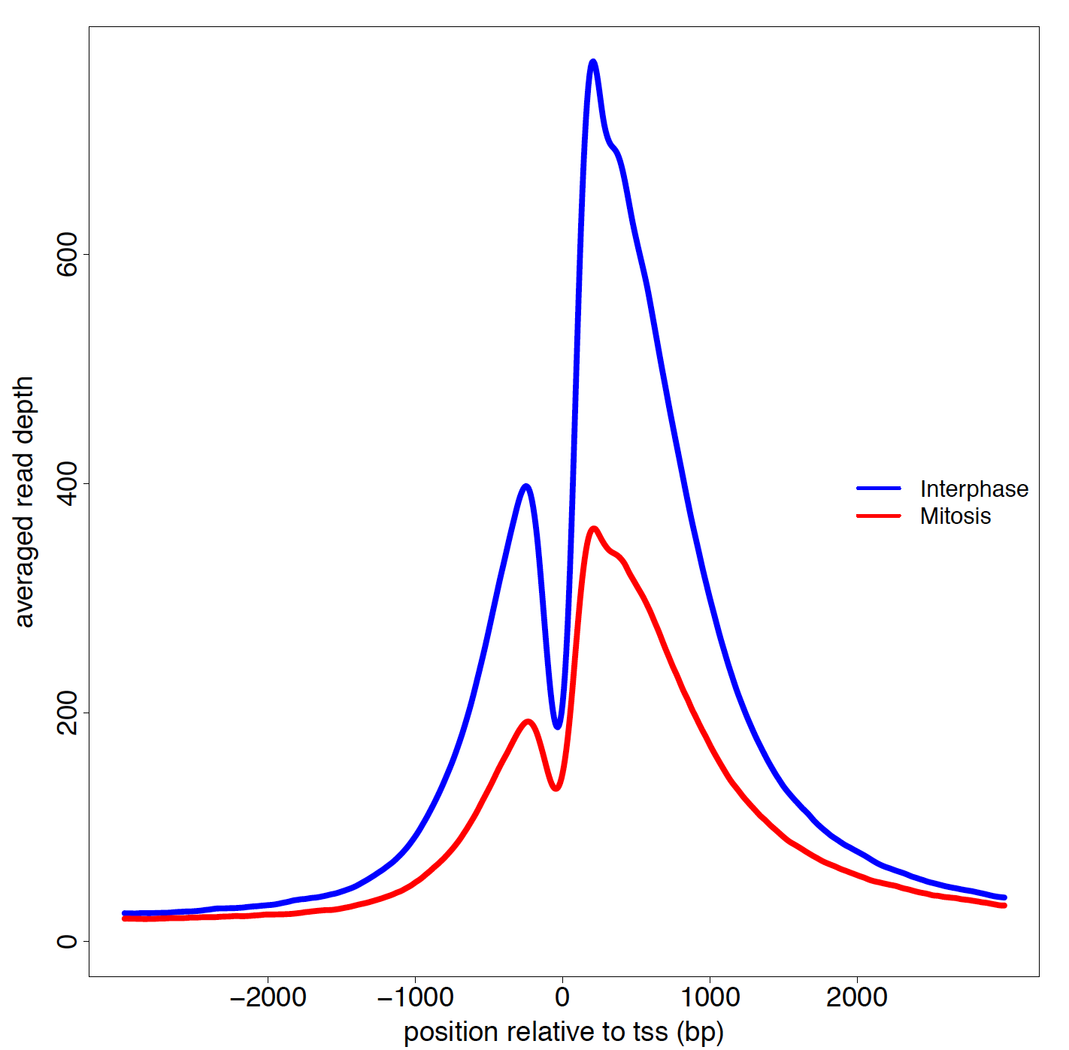
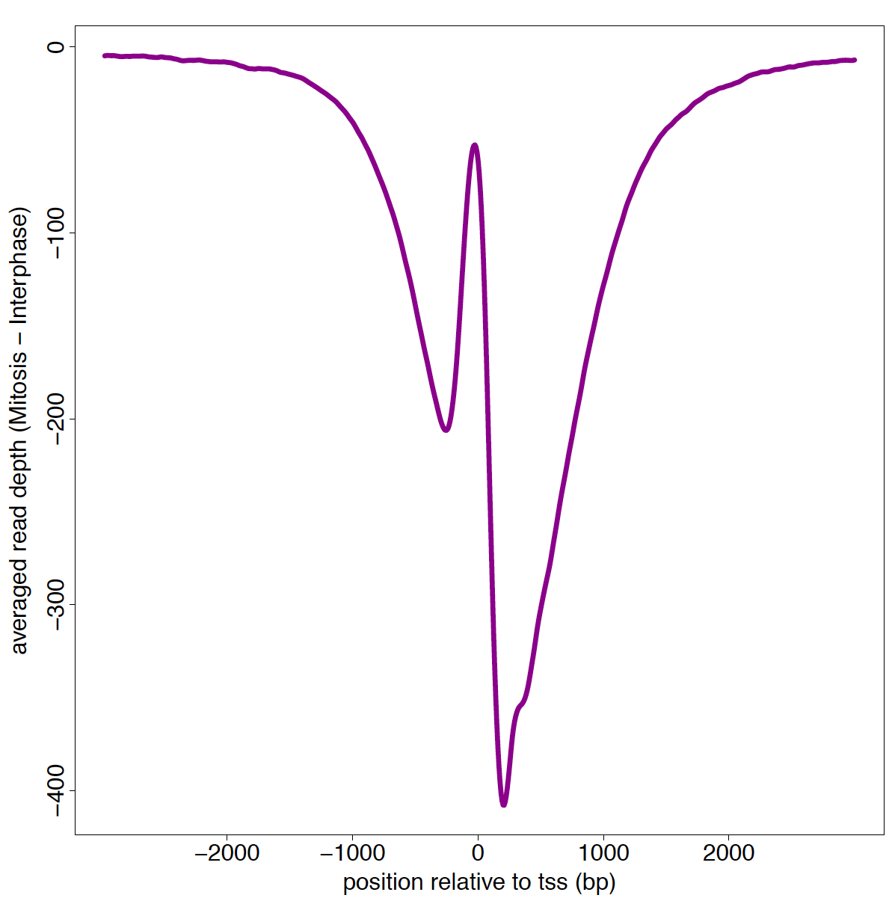
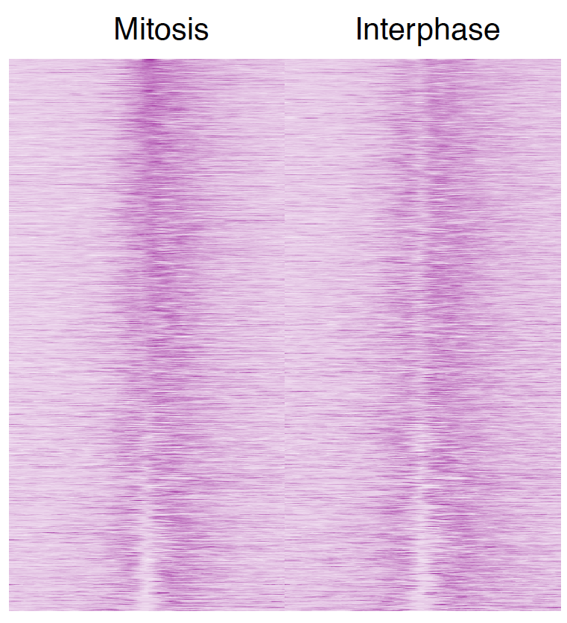
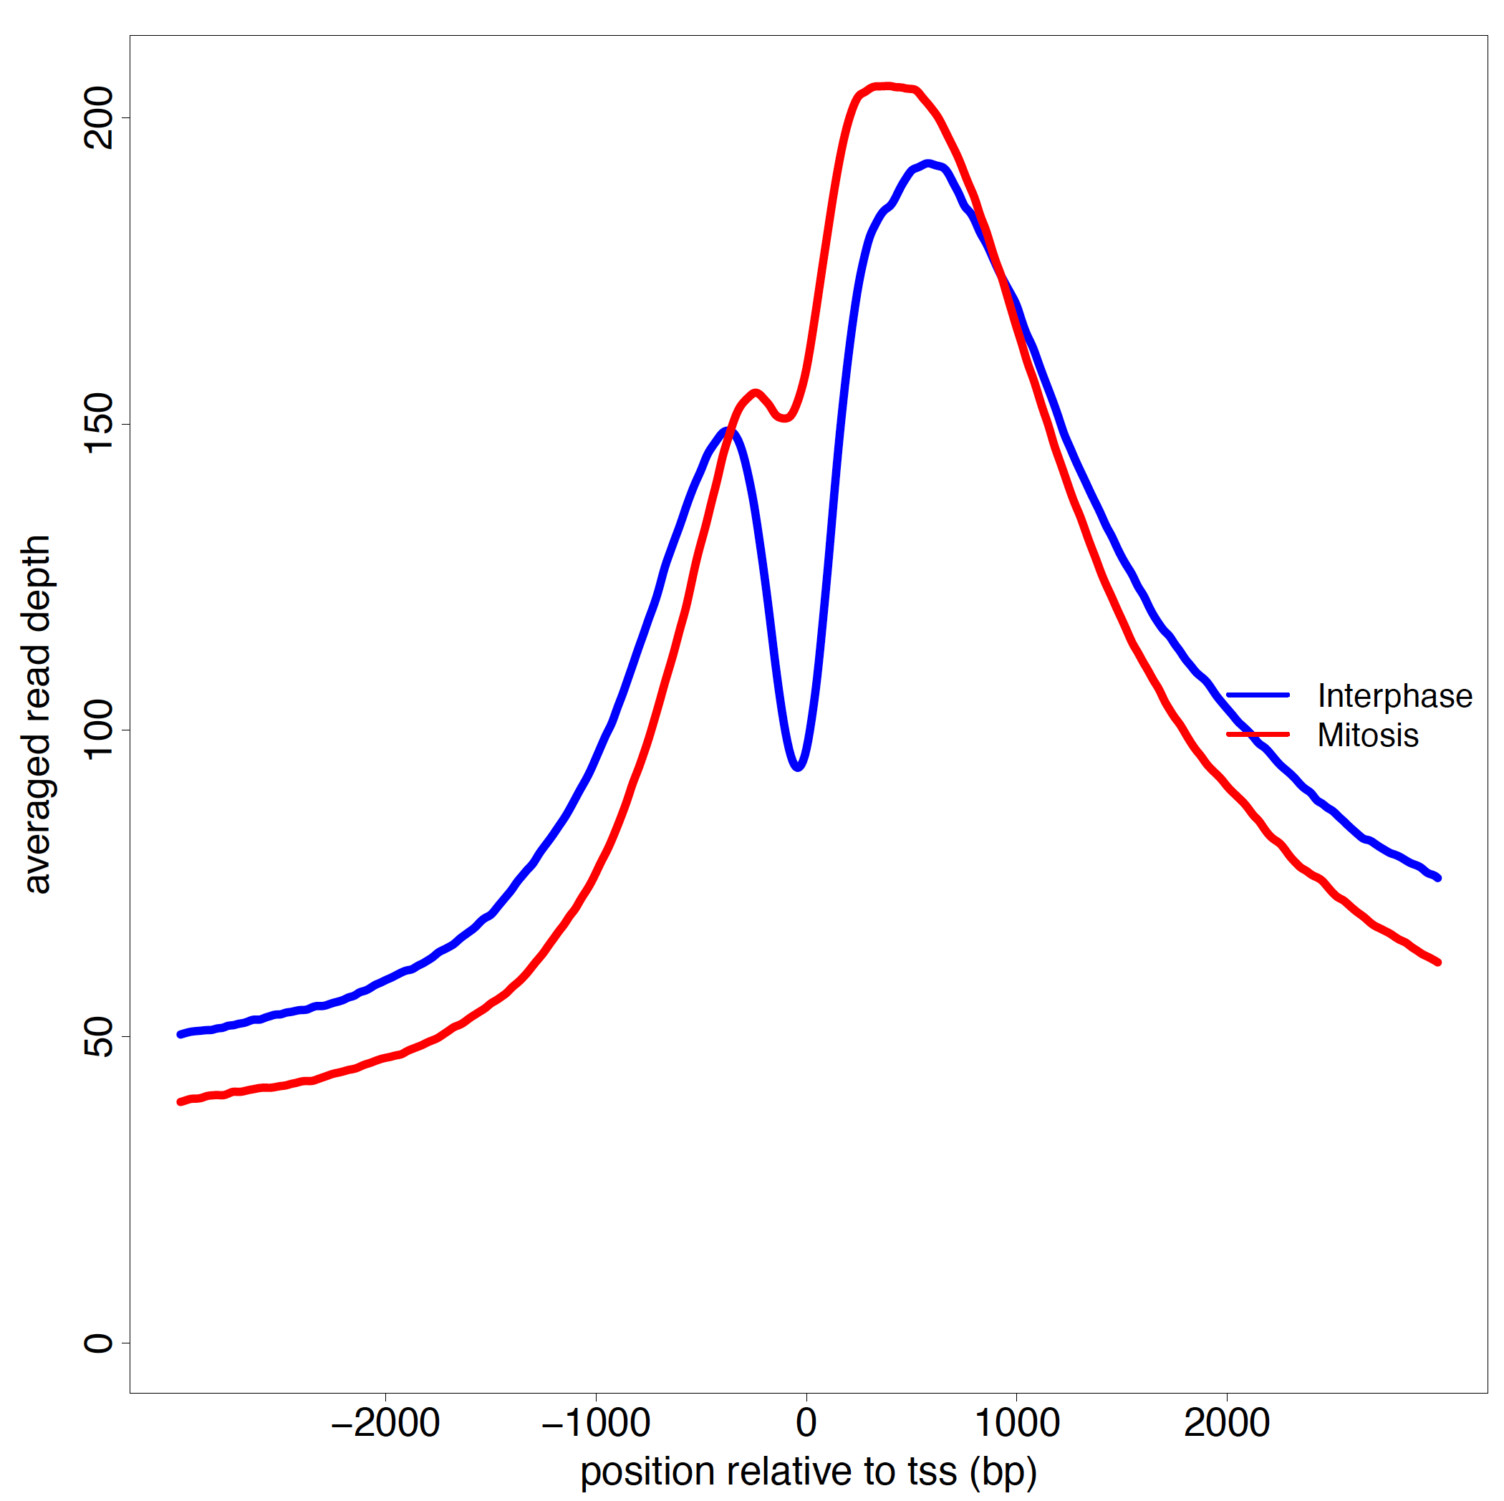
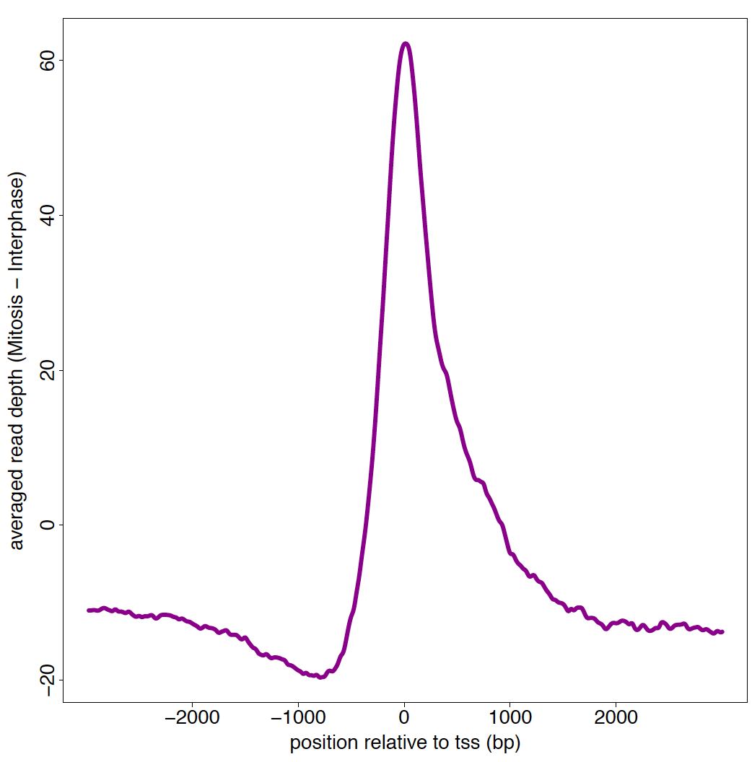
Inhibition of HDACs by TSA removes the acetylation NFR pattern
∆ of Mitosis to Interphase
H3K9ac;
No TSA
Averaged read depth
Averaged read depth (mitosis – Interphase)
Position relative to TSS (bp)
Position relative to TSS (bp)
H3K9ac;
150mM TSA
Position relative to TSS (bp)
Position relative to TSS (bp)
Notes:
Substruction

Slide 14
Characterization of the TSS-associated NDRs
Javasky & Shamir et al., Genome Research 2018
Notes:
5731 genes that are occupied by H3K4me3, H3K9ac, and H3K27ac

Slide 15
Characterization of the TSS-associated NDRs
Javasky & Shamir et al., Genome Research 2018
Notes:
This finding suggests that the NDR patterns
may differentiate between genes that are important promptly following
mitotic exit versus genes that are only necessary later.

Slide 16
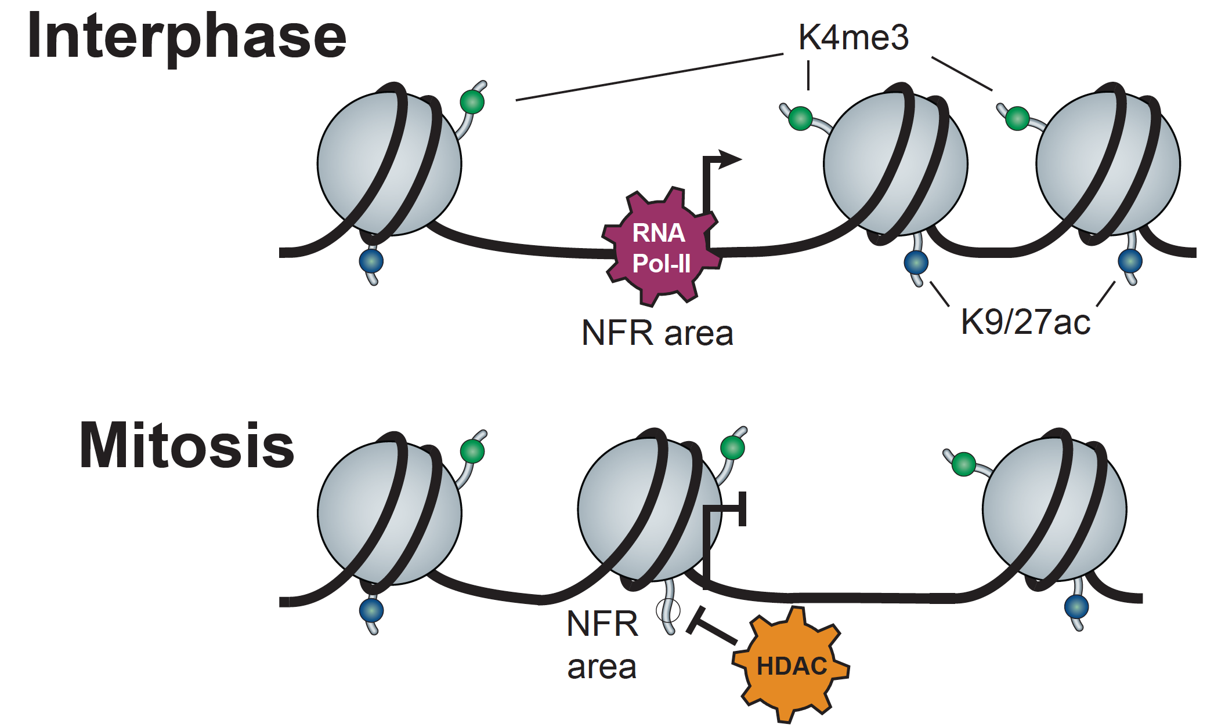
Mitotic nucleosome depositioning
A nucleosome marked with H3K4me3 is present at NFRs during mitosis.
This TSS nucleosome is distinguishable from its surroundings
The +1 nucleosome appears to shift into the NFR area
During mitosis there is specific deaceylation of the shifted nucleosome by HDAC/s

Slide 17






Acknowledgments
Goren Lab:
Sharona Shleizer-Burko
Miguel Alcantar
Yutong Qiu
Laura Yelin-Bekerman
Cynthia Wu
Mark Moyer
Jonathan Young
Catherine Wang
Simon Lab:
Itamar Simon
Elisheva Javasky
Inbal Shamir
Shashi Gandhi
Broad-Israel Science Foundation
Notes:
Thank you for listening, and all these for the help, and these for funding support.

Slide 18
Mitotic nucleosome depositioning
A nucleosome marked with H3K4me3 is present at NFRs during mitosis.
This TSS nucleosome is distinguishable from its surroundings
The +1 nucleosome appears to shift into the NFR area
During mitosis there is specific deaceylation of the shifted nucleosome by HDAC/s

Slide 19
Questions ?

Slide 20
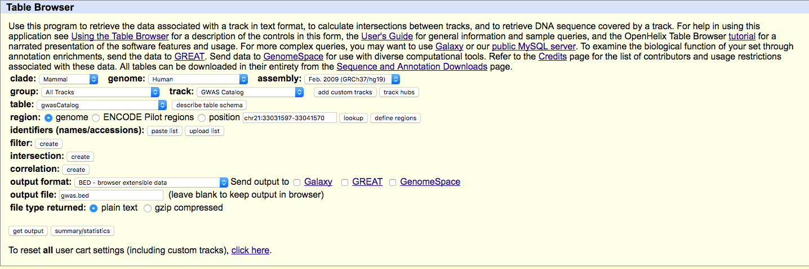
UCSC Genome Browser’s Table Browser
http://genome.ucsc.edu/cgi-bin/hgTables?command=start

Slide 21
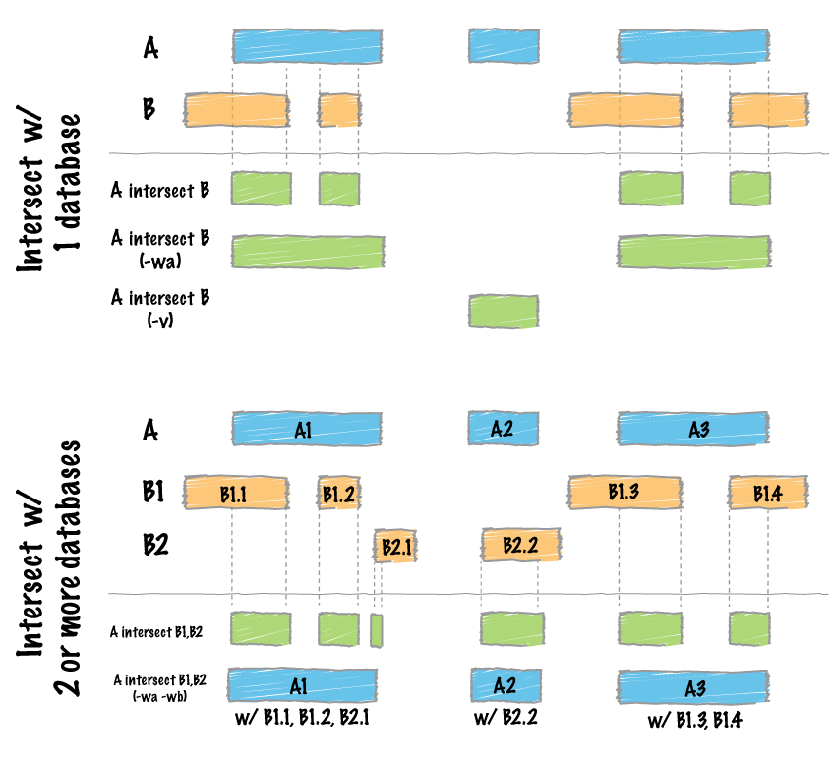
bedtools “intersect”

Slide 22
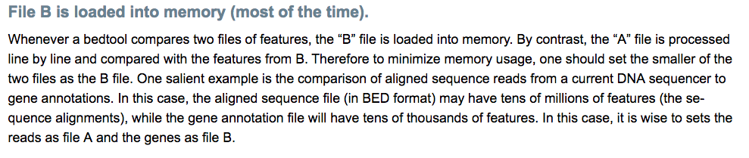
bedtools “intersect”

Slide 23
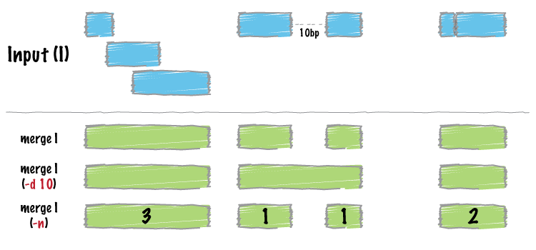
bedtools “merge”

Slide 24
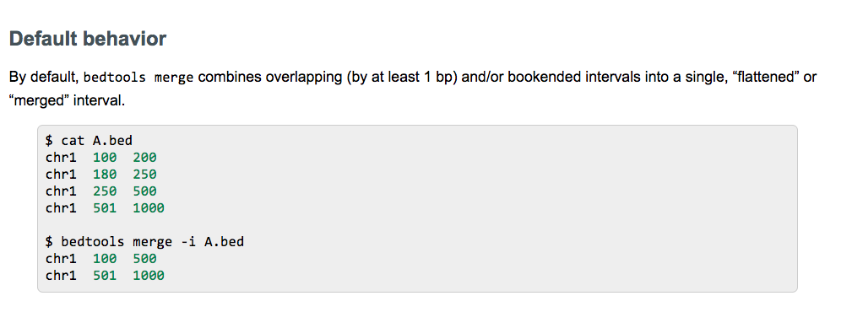
bedtools “merge”

Slide 25
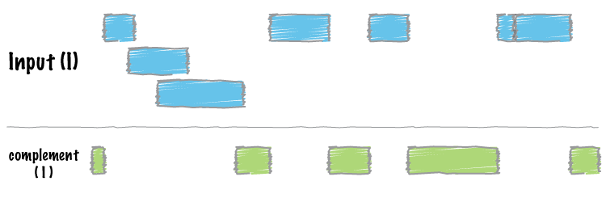
bedtools “complement”

Slide 26
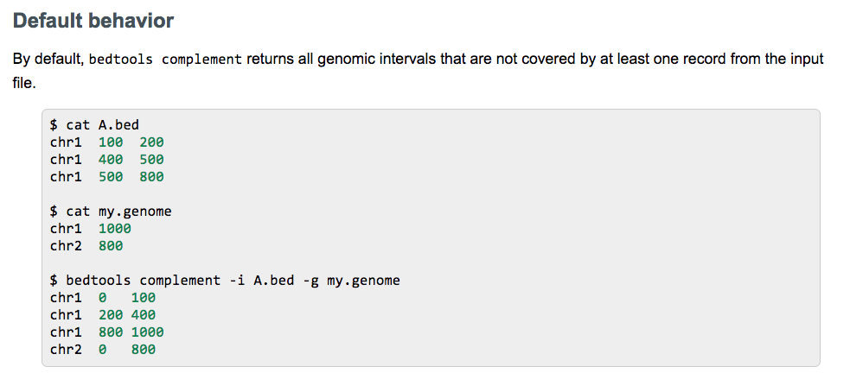
bedtools “complement”

Slide 27
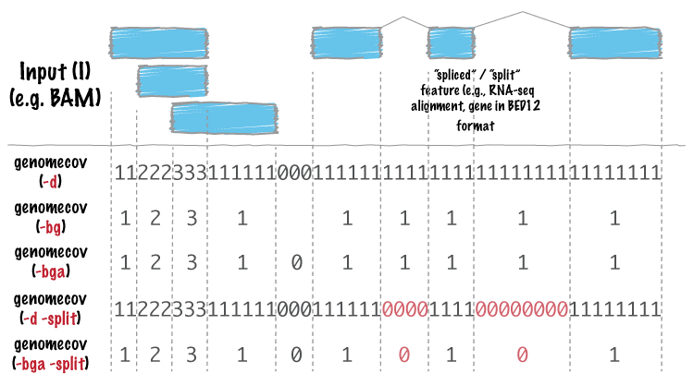
bedtools “genomecov”

Slide 28
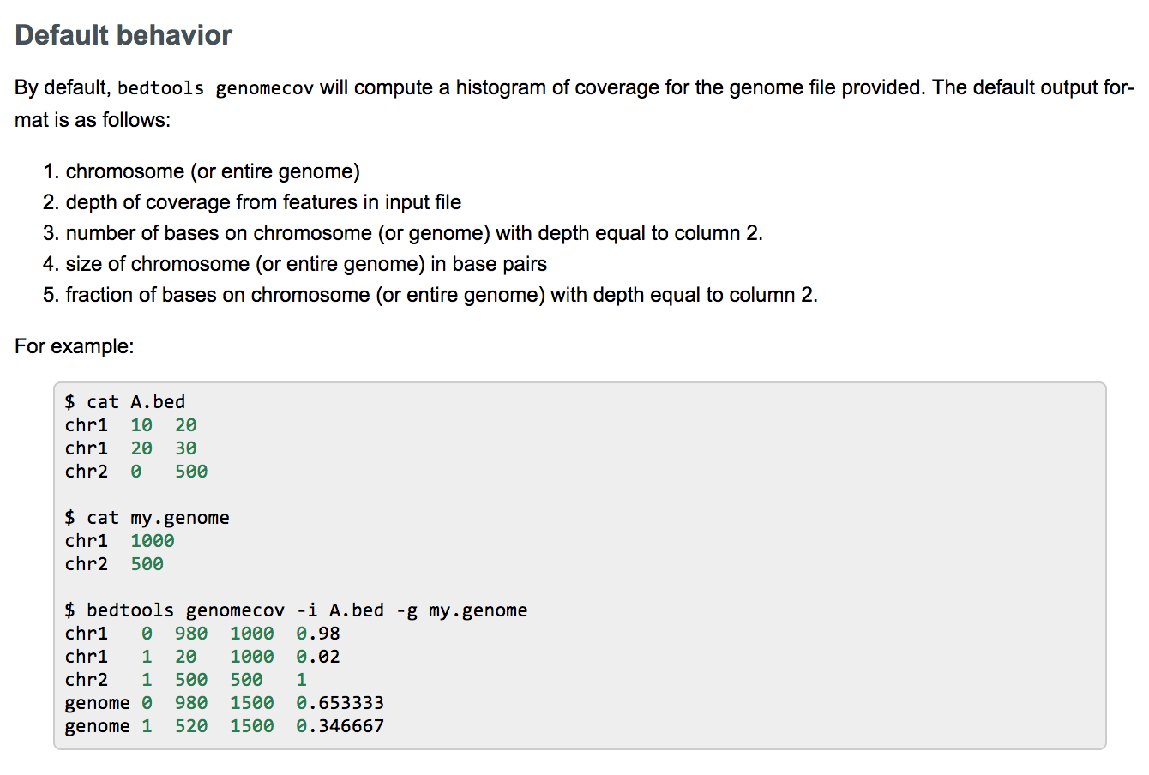
bedtools “genomecov”
http://bedtools.readthedocs.io/en/latest/content/tools/genomecov.html

Slide 29
Extras

Slide 30
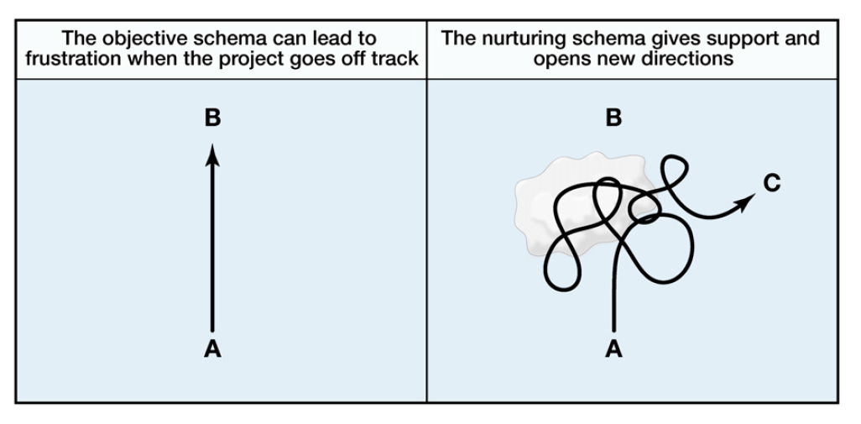
Nurturing (Uri Alon)
Alon, Mol Cell 2009

Slide 31
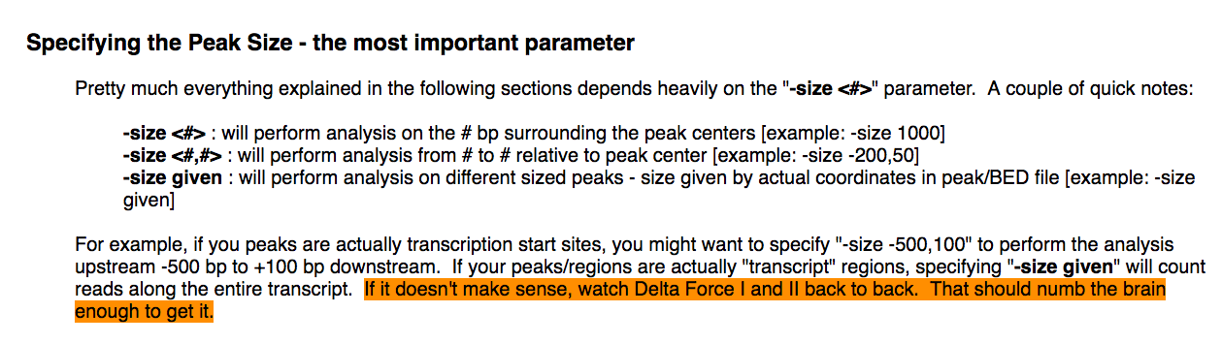
http://homer.ucsd.edu/homer/ngs/quantification.html

Slide 32
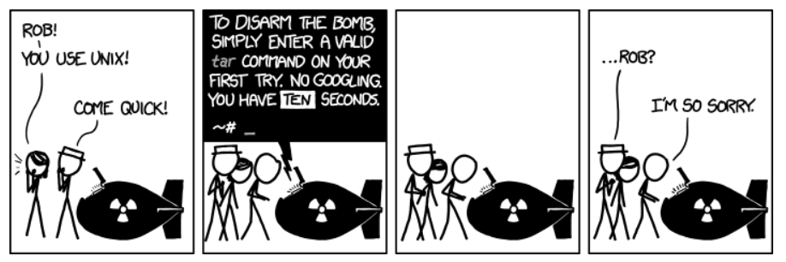
tar
https://xkcd.com/1168/

